Slide 1
Altera DE 2 demo instructions for Kactus 2 Design environment

Slide 2
Intro
This demo describes step by step how to generate top-level VHDL and Quartus project from Kactus2 DE
This very simple demo is designed for Altera DE2 development board. SoC instantiates two components: sig_gen and port blinker. Sig_gen reads switch[17] from DE2 board and activates port_ blinker to blink ledr[0] in DE2 Board. Reset is located in SW[0]

Slide 3
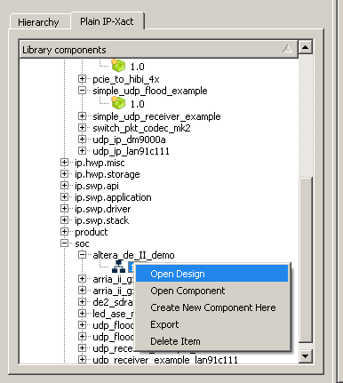
1. Open demo design

Slide 4
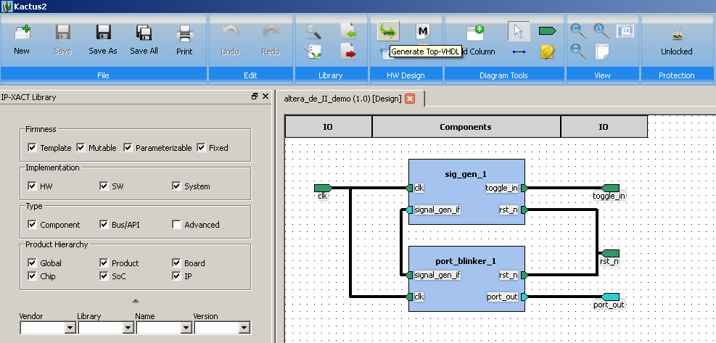
2. Generate top-level VHDL
Remember to unlock the design

Slide 5
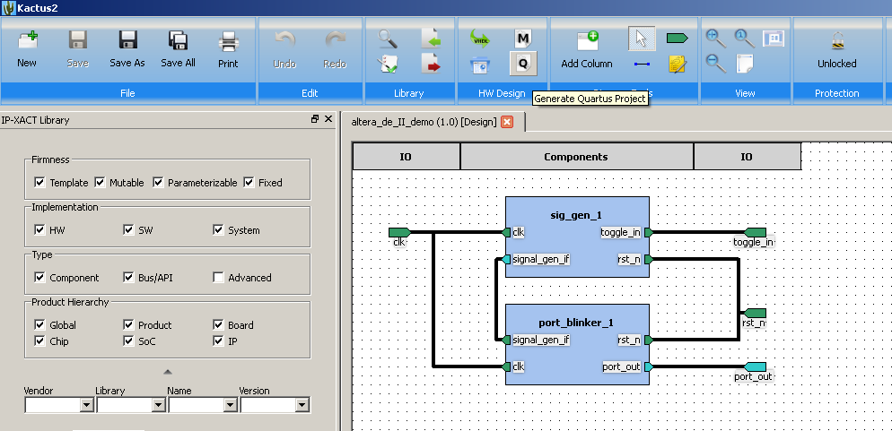
3. Generate Quartus Project

Slide 6
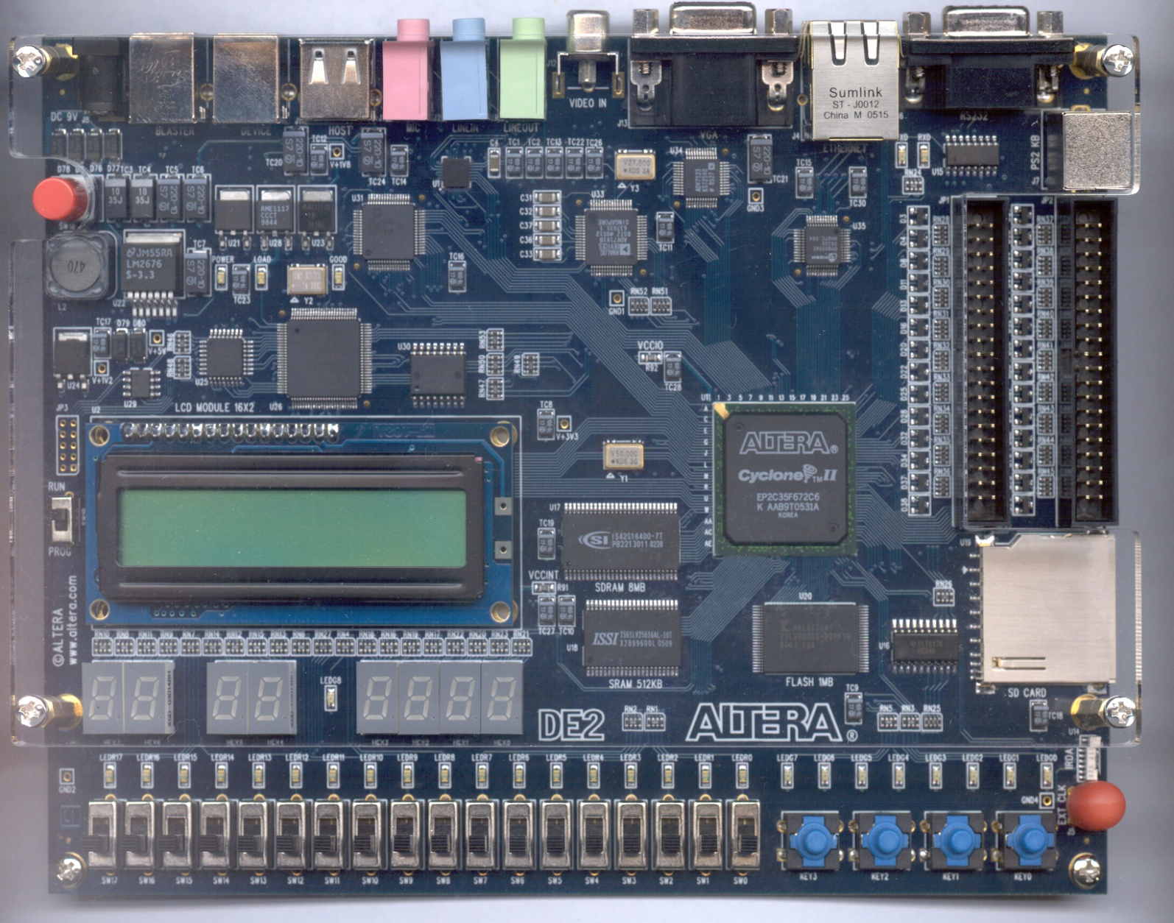
4. Compile and synthesize created project
BLINKING LED
RESET
TOGGLE

